Slide 1

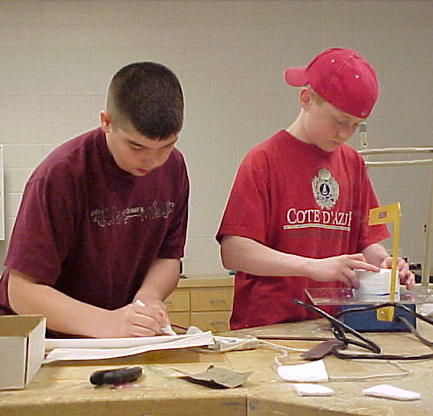
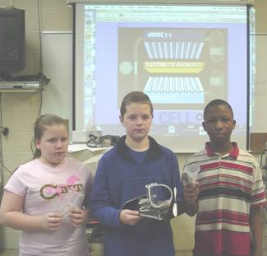




Foundations of Technology
Engineering Design Process
Teacher Resource – First Five Days: Day 2
© 2016 International Technology and Engineering Educators Association
STEM Center for Teaching and Learning™
Foundations of Technology
Notes:
© International Technology Education Assoc
Slide #<number>
TITLE SLIDE
12/01/2009
STEMCenter for Teaching & Learning™ Engineering byDesign™

Slide 2

The BIG Idea
Big Idea:
The engineering design process is an iterative method that people use to solve problems.
© 2016 International Technology and Engineering Educators Association
STEM Center for Teaching and Learning™
Foundations of Technology
Notes:
[Authors: Please include teacher notes appropriately.]
© International Technology Education Assoc
Slide #<number>
12/01/2009
STEMCenter for Teaching & Learning™ Engineering byDesign™

Slide 3

Design
Discussion Questions:
  What is design?
  What influences design?
  Who is a designer?
  What process do people use to design?
© 2016 International Technology and Engineering Educators Association
STEM Center for Teaching and Learning™
Foundations of Technology
Notes:
[Authors: Please include teacher notes appropriately.]
© International Technology Education Assoc
Slide #<number>
12/01/2009
STEMCenter for Teaching & Learning™ Engineering byDesign™

Slide 4
What is Design
Design is many things:
  Design is the best use of tools, machines, materials, and processes to create a solution to a problem.
  Design connects a person to his/her environment.
  Your whole day involves design.
© 2016 International Technology and Engineering Educators Association
STEM Center for Teaching and Learning™
Foundations of Technology
Notes:
[Authors: Please include teacher notes appropriately.]
© International Technology Education Assoc
Slide #<number>
12/01/2009
STEMCenter for Teaching & Learning™ Engineering byDesign™

Slide 5
What Influences Design
Good design is finding the best solution to a problem.
Good design follows a set of given or identified guidelines also known as criteria and constraints:
  Criteria = Guidelines
  Constraints = Limitations
© 2016 International Technology and Engineering Educators Association
STEM Center for Teaching and Learning™
Foundations of Technology
Notes:
Question: Based on the design challenge completed yesterday, can students list criteria and constraints that influenced their design?
© International Technology Education Assoc
Slide #<number>
12/01/2009
STEMCenter for Teaching & Learning™ Engineering byDesign™

Slide 6



Who is a Designer
You are a designer whether you know it or not!
    Selecting the clothes you wear
    Drawing in your notebook
    Arranging your room
© 2016 International Technology and Engineering Educators Association
STEM Center for Teaching and Learning™
Foundations of Technology
Notes:
Question: For any of the scenarios listed above, can student define a criteria or constraint that influenced their design?
© International Technology Education Assoc
Slide #<number>
12/01/2009
STEMCenter for Teaching & Learning™ Engineering byDesign™

Slide 7



What is NOT Designed
The Natural Environment
Anything man-made has been designed!
© 2016 International Technology and Engineering Educators Association
STEM Center for Teaching and Learning™
Foundations of Technology
Notes:
[Authors: Please include teacher notes appropriately.]
© International Technology Education Assoc
Slide #<number>
12/01/2009
STEMCenter for Teaching & Learning™ Engineering byDesign™

Slide 8



What Process Do People use to Design
The Engineering Design Process is an on-going or iterative method that people use to solve problems.
© 2016 International Technology and Engineering Educators Association
STEM Center for Teaching and Learning™
Foundations of Technology
Notes:
[Authors: Please include teacher notes appropriately.]
© International Technology Education Assoc
Slide #<number>
12/01/2009
STEMCenter for Teaching & Learning™ Engineering byDesign™

Slide 9
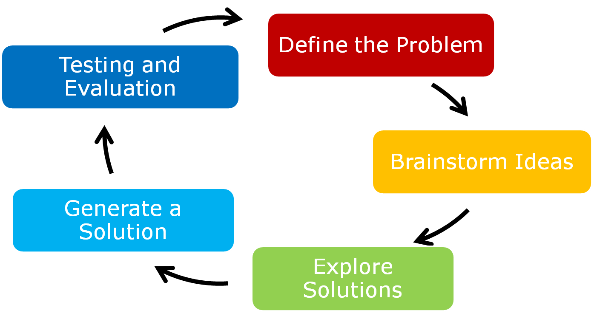

The SIMPLE
Engineering Design Process
© 2016 International Technology and Engineering Educators Association
STEM Center for Teaching and Learning™
Foundations of Technology
Notes:
[Authors: Please include teacher notes appropriately.]
© International Technology Education Assoc
Slide #<number>
12/01/2009
STEMCenter for Teaching & Learning™ Engineering byDesign™

Slide 10
Defining the Problem
Typically includes developing a specific problem statement that identifies the what, who, when, and how the problem should be addressed.
  What is the real problem that requires a solution?
  What are the goals and objectives in solving the problem?
  Who or what does the problem affect or impact?
  Identify shortcomings and other issues.
© 2016 International Technology and Engineering Educators Association
STEM Center for Teaching and Learning™
Foundations of Technology
Notes:
[Authors: Please include teacher notes appropriately.]
© International Technology Education Assoc
Slide #<number>
12/01/2009
STEMCenter for Teaching & Learning™ Engineering byDesign™

Slide 11
Brainstorming Solutions
Typically includes brainstorming solutions and evaluating all ideas to determine the best possible solution.
  Brainstorm as many possible solutions to the problem as you can generate.
  Revisit the criteria and constraints for the problem.
  Evaluate and analyze your solutions.
  Select the best solution and formulate a plan for development.
© 2016 International Technology and Engineering Educators Association
STEM Center for Teaching and Learning™
Foundations of Technology
Notes:
[Authors: Please include teacher notes appropriately.]
© International Technology Education Assoc
Slide #<number>
12/01/2009
STEMCenter for Teaching & Learning™ Engineering byDesign™

Slide 12
Exploring Solutions
Typically includes researching the problem and identifying technology that could be used to resolve the problem.
  How was the problem or a similar problem addressed in the past?
  What are the criteria and constraints for this problem?
  What current technologies are available that could be used to solve the problem?
  What are potential impacts of the solution?
© 2016 International Technology and Engineering Educators Association
STEM Center for Teaching and Learning™
Foundations of Technology
Notes:
[Authors: Please include teacher notes appropriately.]
© International Technology Education Assoc
Slide #<number>
12/01/2009
STEMCenter for Teaching & Learning™ Engineering byDesign™

Slide 13


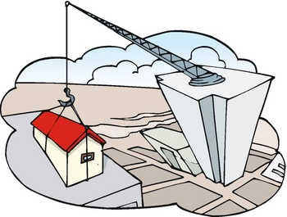
Generate a Solution
Typically includes, “bringing your solution to life.”
  Synthesize your design into a tangible, working product by developing models or prototypes.
© 2016 International Technology and Engineering Educators Association
STEM Center for Teaching and Learning™
Foundations of Technology
Notes:
[Authors: Please include teacher notes appropriately.]
© International Technology Education Assoc
Slide #<number>
12/01/2009
STEMCenter for Teaching & Learning™ Engineering byDesign™

Slide 14
Testing and Evaluation
Typically includes testing and evaluating your project against the problem statement as well as the criteria and constraints.
  Does the solution solve the problem?
  What went right or wrong? And, how can the process be improved?
  Did the solution cause another problem?
  Does the solution have another use?
© 2016 International Technology and Engineering Educators Association
STEM Center for Teaching and Learning™
Foundations of Technology
Notes:
[Authors: Please include teacher notes appropriately.]
© International Technology Education Assoc
Slide #<number>
12/01/2009
STEMCenter for Teaching & Learning™ Engineering byDesign™

Slide 15

Redefining the Problem
After a solution has been tested and evaluated, the process can be repeated to solve unintended problems or to enhance the current solution.
The Engineering Design
Process is an iterative
method that people use
to solve problems.
© 2016 International Technology and Engineering Educators Association
STEM Center for Teaching and Learning™
Foundations of Technology
Notes:
[Authors: Please include teacher notes appropriately.]
© International Technology Education Assoc
Slide #<number>
12/01/2009
STEMCenter for Teaching & Learning™ Engineering byDesign™

Slide 16
The SIMPLE
Engineering Design Process
This slide is already on page 9 – does it need to be used here, too? Ed
© 2016 International Technology and Engineering Educators Association
STEM Center for Teaching and Learning™
Foundations of Technology
Notes:
[Authors: Please include teacher notes appropriately.]
© International Technology Education Assoc
Slide #<number>
12/01/2009
STEMCenter for Teaching & Learning™ Engineering byDesign™

